Slide 1
Paper Reading:
Bag of Tricks for Image Classification with Convolutional Neural Networks

Slide 2
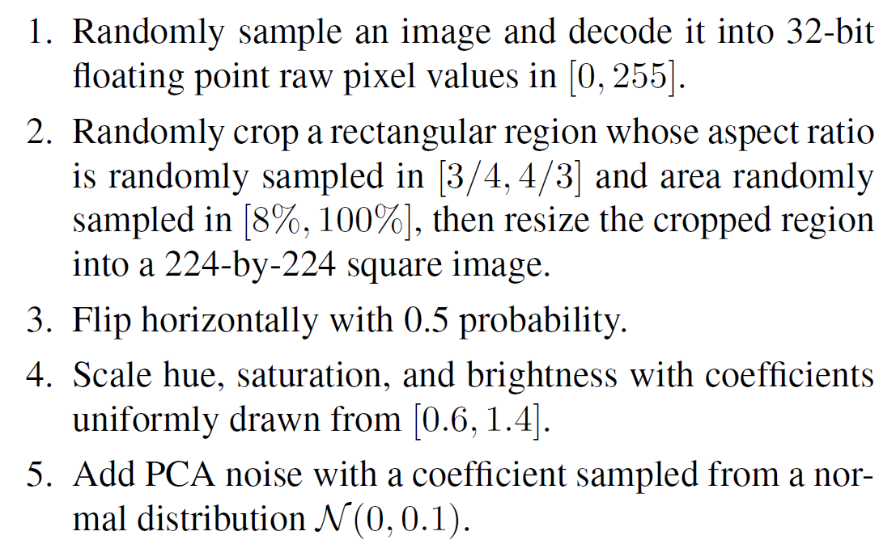
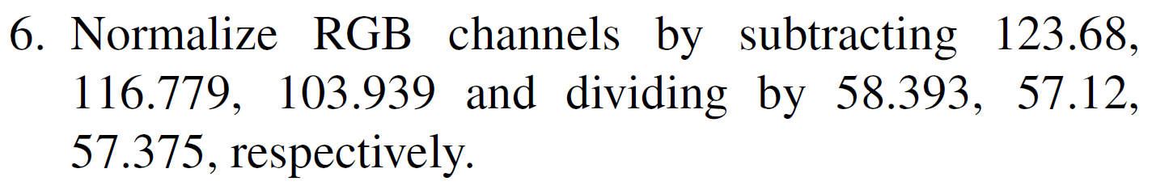

Slide 3
Data
Mix-up Training
Model
Model Tweaks
Low-precision Training
Loss
Label Smoothing
Optimization
Linear Scale Learning Rate
Learning Rate Warmup
Zero gamma
No weight decay for bias
Cosine Learning Rate Decay
Knowledge Distillation

Slide 4
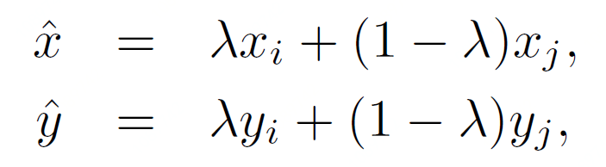
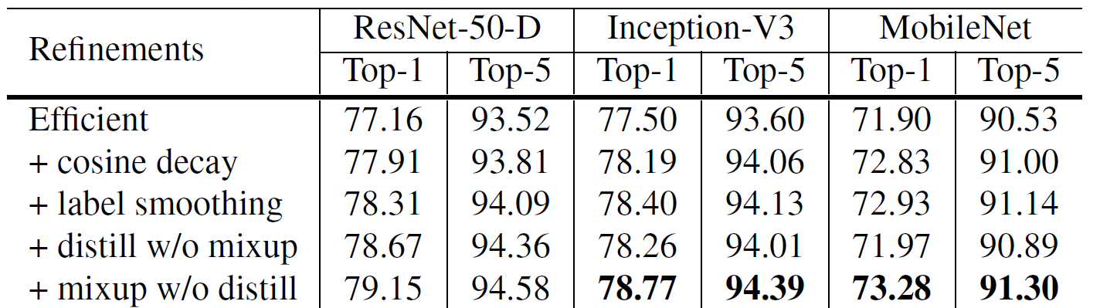
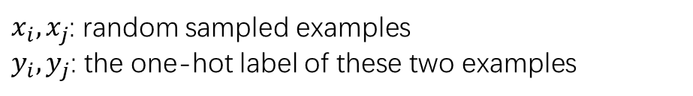
Mix-up Training
1. What ?
2. Why ?
Interpolate in input space.
Control overfitting
$x_{i}, x_{j}$: random sampled examples
$y_{i}, y_{j}$: the one-hot label of these two examples
3. Improvement

Slide 5
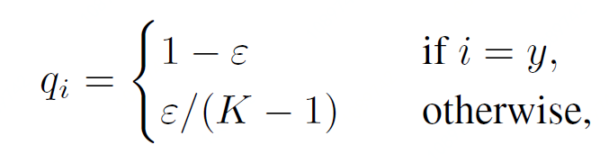
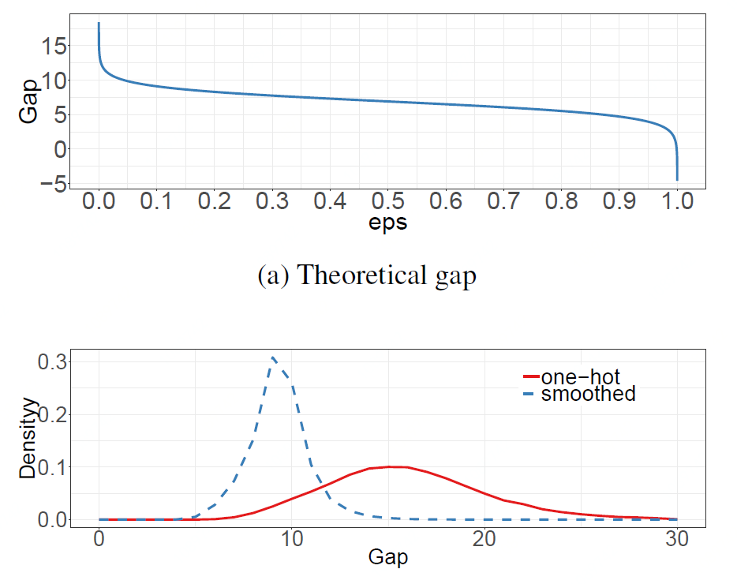
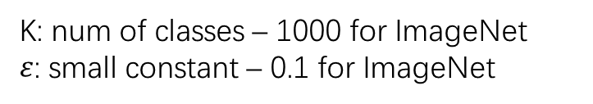
Label Smoothing
1. What ?
2. Why ?
Add noise to labels → Avoid overfitting
Avoid the confidence too strong
K: num of classes – 1000 for ImageNet
$ε$: small constant – 0.1 for ImageNet
3. Improvement

Slide 6
Linear Scaling Learning Rate
1. What ?
2. Why ?
Initial LR | Batch Size
0.1 | 256
Current LR | b
Large Batch → Reduce Var(gradient) → Go Further
From [ResNet]
* Align optimization step of each sample
Current LR = 0.1 x b / 256
3. When ?
Train with Large Batch

Slide 7
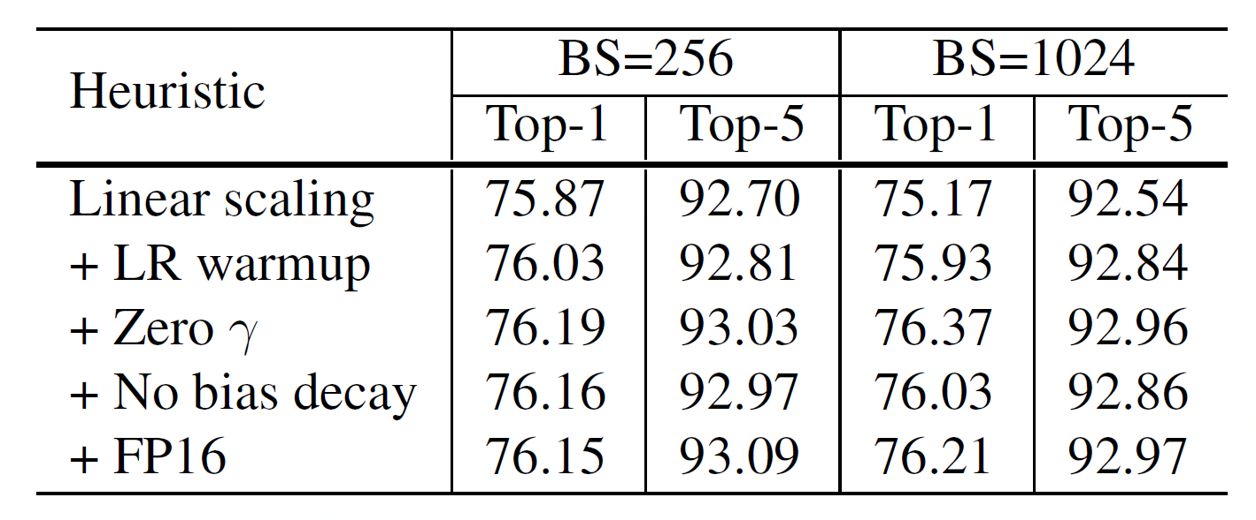
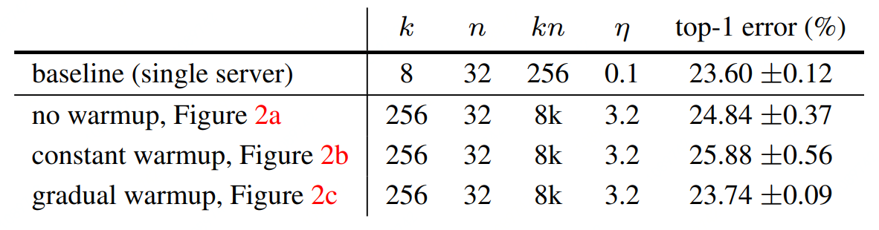
Learning Rate Warmup
1. What ?
2. Why ?
Start with small LR, train with initial LR.
Make LR grow linearly until the warm up end.
For numerical stability.
LR = initial LR, when i > m,
i * initial LR / m, when i < m.
m is num batches to warmup, i is current batch num
3. When ?
4. Improvement
At the beginning of the training

Slide 8
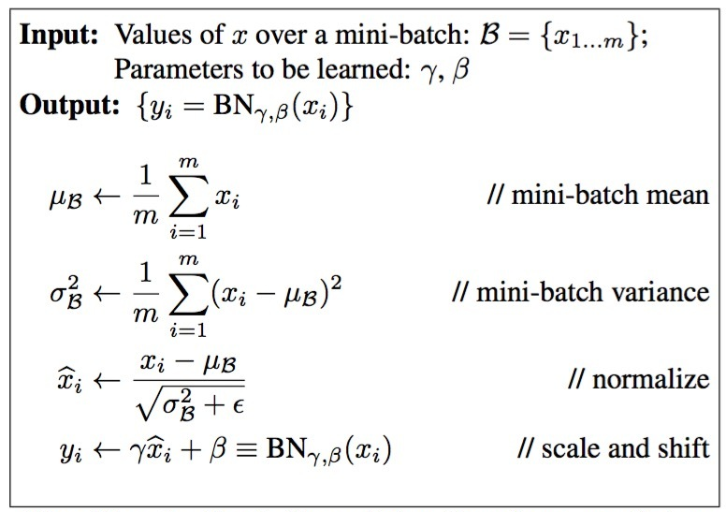

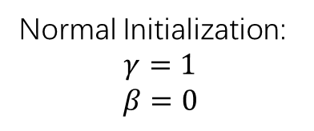

Zero Gamma for BN
1. What ?
2. Why ?
If $γ=0，$y = 0 * x + 0 = 0
Normal Initialization:
$$γ=1$$
$$β=0$$
Enable shortcut, and easy to start
When Initial, Set $γ=0$
3. When ?
4. Improvement
At the start of training.
Short-cut related.

Slide 9
No weight decay for bias
1. What ?
2. Why ?
Bias have much less parameters compared to weights → less variance
regularizing would introduce underfitting
Don’t add weight decay to bias in NN.
4. Improvement

Slide 10
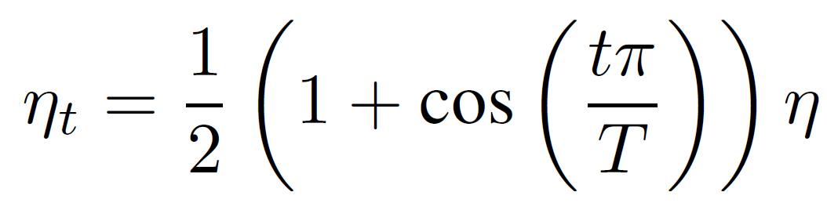
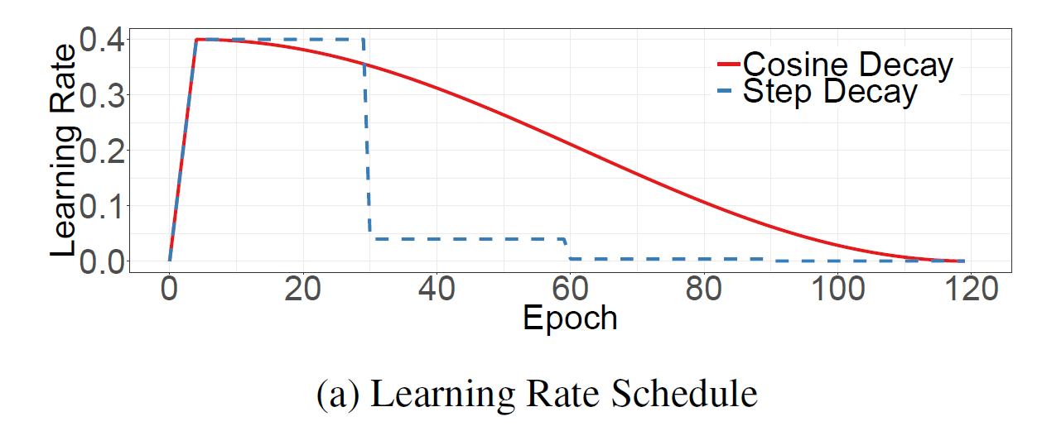

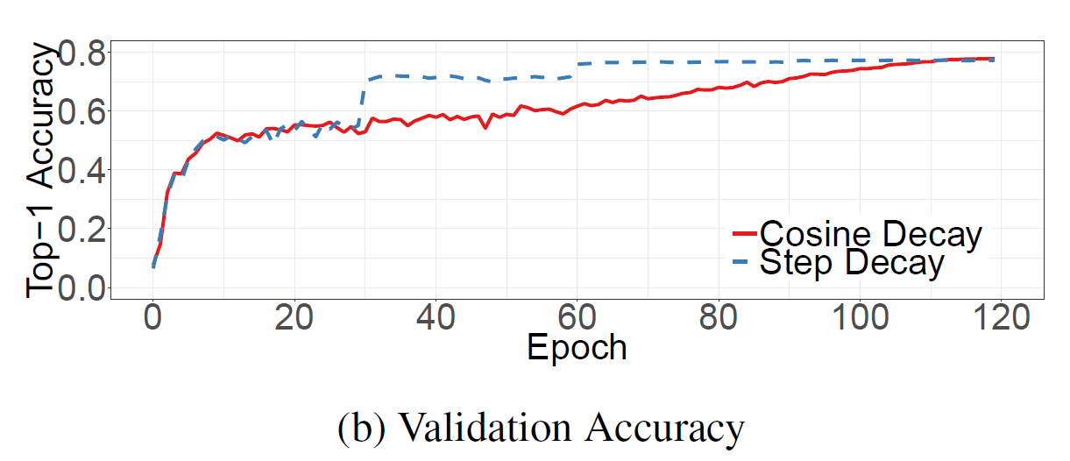
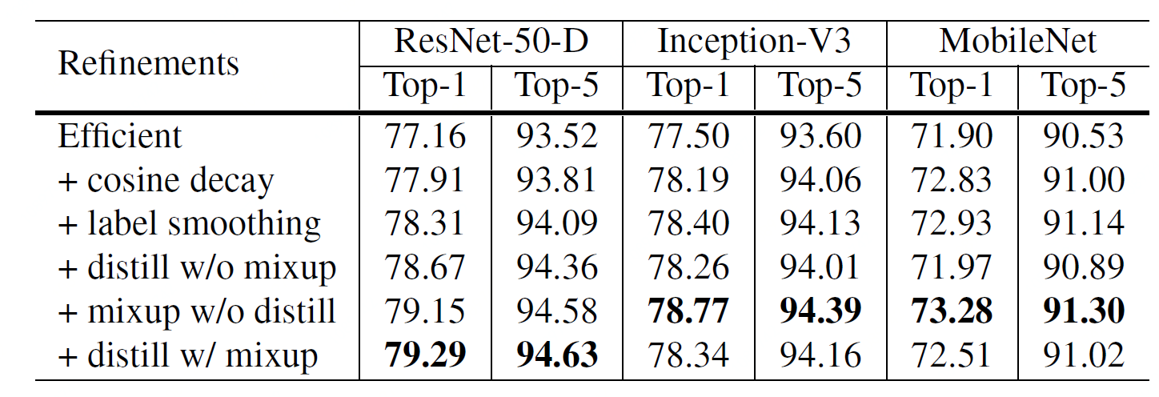
Cosine Learning Rate Decay
1. What ?
2. Effect
T: total number of batches
t: current batch
: initial learning rate
3. Improvement

Slide 11
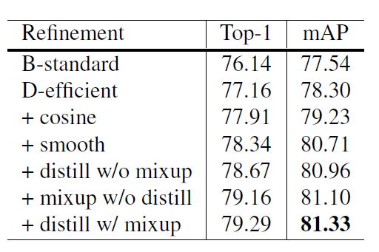
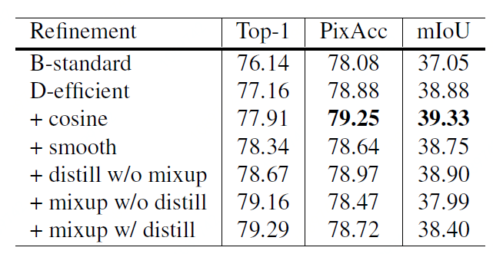
Improvements on Detection / Segmentation

Slide 12
Low-precision Training
1. What ?
2. Why ?
3. When ?
4. Improvement

Slide 13
Knowledge Distillation
1. What ?
2. Why ?
3. When ?
4. Improvement

